Slide 1
Transmission Media
for
Telecommunication Networks
SP-08
Copyright Seema Ansari

Slide 2
Data Communications
What is Telecommunications ?
Telecommunications: Any process that permits the passage from a sender to one or more receivers of information of any nature delivered in an easy to use form (printed copy, fixed or moving pictures visible or audible signals, etc.) by any electromagnetic system (electrical transmission by wire, radio, optical transmission, guided waves etc.) includes telegraphy, telephony, video telephony, data transmission, etc.
SP-08
Copyright Seema Ansari

Slide 3
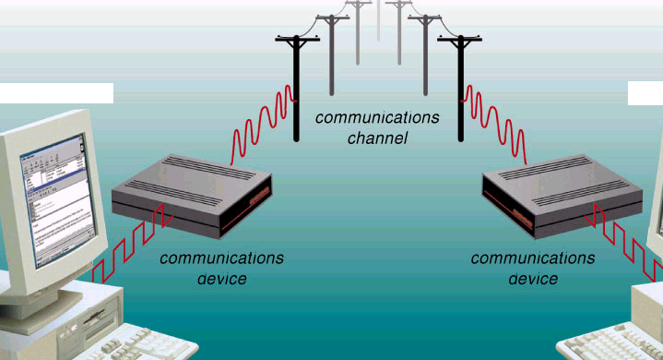
A basic model of communications
Modem
Modem
Sending device
Receiving device
SP-08
Copyright Seema Ansari

Slide 4
TRANSMISSION MEDIA
Types of transmission media :
Guided Media
(Physical transmission media)
2. Unguided Media
(Wireless transmission media)
SP-08
Copyright Seema Ansari

Slide 5
Guided transmission media
Guided Transmission Media :
uses wire or cable to send communication signals
tangible materials
Example:
twisted-pair cable
coaxial cable
fiber-optic cable
SP-08
Copyright Seema Ansari

Slide 6
Unguided transmission media
Unguided transmission media :
uses the following for sending signals:
  space
  air
  microwaves
  infrared signals
SP-08
Copyright Seema Ansari

Slide 7
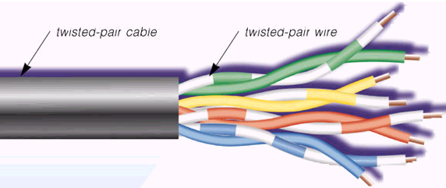
Twisted-Pair cable
SP-08
Copyright Seema Ansari

Slide 8
Twisted pair cable
Most popular network cable
Lightweight
Easy to install
Inexpensive
Supports speeds upto 100Mbps
Each pair of wire is twisted together to minimize signal distortion from adjacent wire pairs. Example: telephone wires
Twists are done to reduce the effects of EMI and cross talks
Two types: Unshielded twisted pair (UTP) and Shielded Twisted pair (STP)
SP-08
Copyright Seema Ansari

Slide 9
Twisted pair cable
UTP: - Cost less than STP
Can be either voice grade or data grade
UTP-Cat-5: used in data comm., can support upto 100 Mbps.
Susceptible to EMI
Can run over short distances due to attenuation
STP: has a mesh shielding that protects it from EMI.
Allows for longer distances without errors
Transmission rates as high as 100Mbps
SP-08
Copyright Seema Ansari

Slide 10
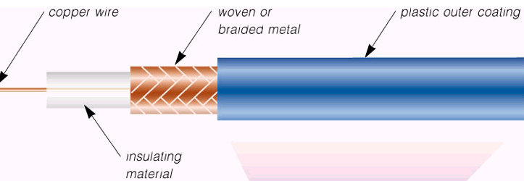
Coaxial cable
SP-08
Copyright Seema Ansari

Slide 11
Coaxial cable
Example : Cable TV wire
Has two conductors parallel to each other, hence coaxial
Central conductor is copper
Outer conductor is a fine mesh made from copper. It shields the cable from EMI.
Transmission rates upto 400 Mbps (theoretically)
Can run upto 10miles or less.
ADV: easy to wire
Inexpensive
Easy to expand
SP-08
Copyright Seema Ansari

Slide 12
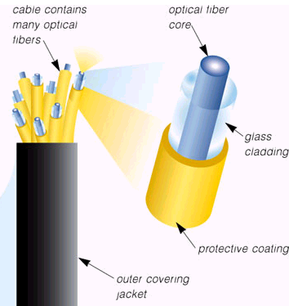
Fiber-optic cable
SP-08
Copyright Seema Ansari

Slide 13
Fiber-optic cable
Fiber-Optic Cable:
lighter
transmits data faster than twisted and coaxial cable
very low noise susceptibility
can carry more signals than twisted and coaxial cables
provides better security for signals during data transmission.
Tr. rates upto 2 Gbps
SP-08
Copyright Seema Ansari

Slide 14
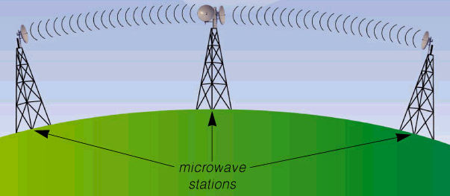
Microwaves
radio waves that provides a high-speed data transmission (45 Mbps).
used to transfer signals from one microwaves station to another station.
Microwaves make use of land based stations only.
Each microwaves station is an earth-based that consists of a reflective dish with an antenna, transceivers and other equipments to do microwaves communications.
SP-08
Copyright Seema Ansari

Slide 15
Microwaves (10¹¹Hz)
Disadvantages:
Microwaves are limited to line-of-sight transmission.
  transmitted in a straight line.
  should not have any obstructions between microwaves antennas.
  To overcome this microwave stations are positioned on the top of buildings or towers or mountains.
SP-08
Copyright Seema Ansari

Slide 16
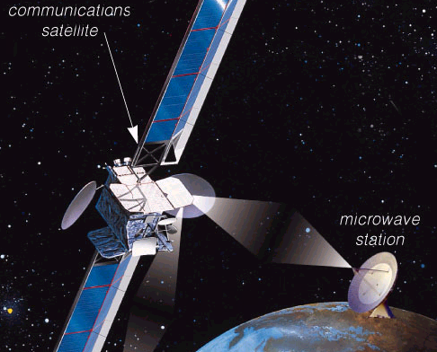
Communication Satellite
A space station that receives microwaves signals from an earth-based station,amplifies that signals,and then broadcasts the amplified signals back to the earth-based stations.
earth stations are microwave stations.
Satellite uses both land based stations and orbiting station.
SP-08
Copyright Seema Ansari

Slide 17
Satellite (10⁹ Hz)
Uplink
data transmission from an earth station to a satellite
downlink
data transmission from a satellite to an earth station
SP-08
Copyright Seema Ansari

Slide 18
Satellite
Communication satellites are used in :
air navigations
television radio broadcasts
videoconferencing, and
telephone
SP-08
Copyright Seema Ansari

Slide 19
Infrared Transmission(10¹⁴ Hz)
Uses line of sight Technology
Used to provide LAN connections between buildings and also is the medium used in some wireless LANs.
Data Tr. Rates = 4Mbps or less.
SP-08
Copyright Seema Ansari

